Slide 1
Class Diagram: Spacey
Presented By: Arif Shariar Rahman 1705095
Group Members: 1705096 1705102 1705104 1705120

Slide 2
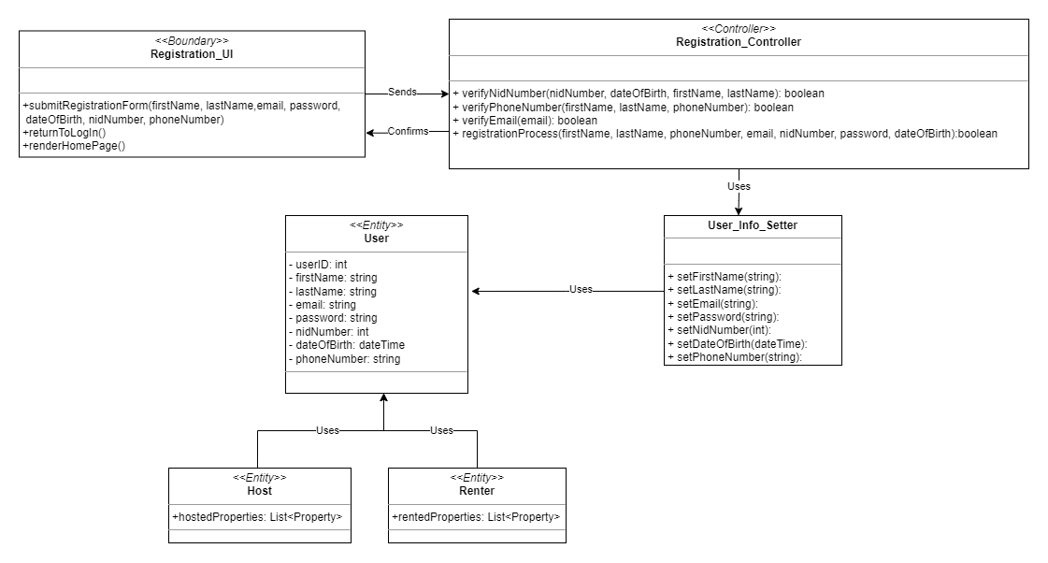
Registration

Slide 3
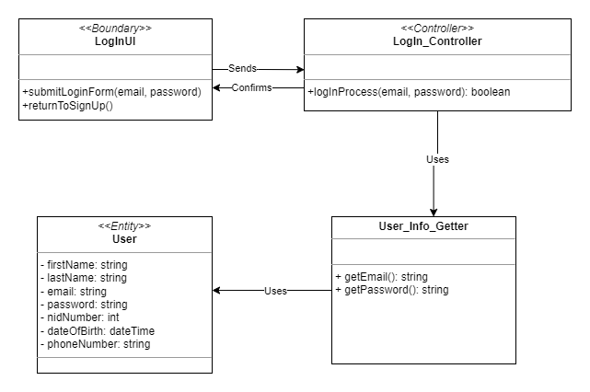
Login

Slide 4
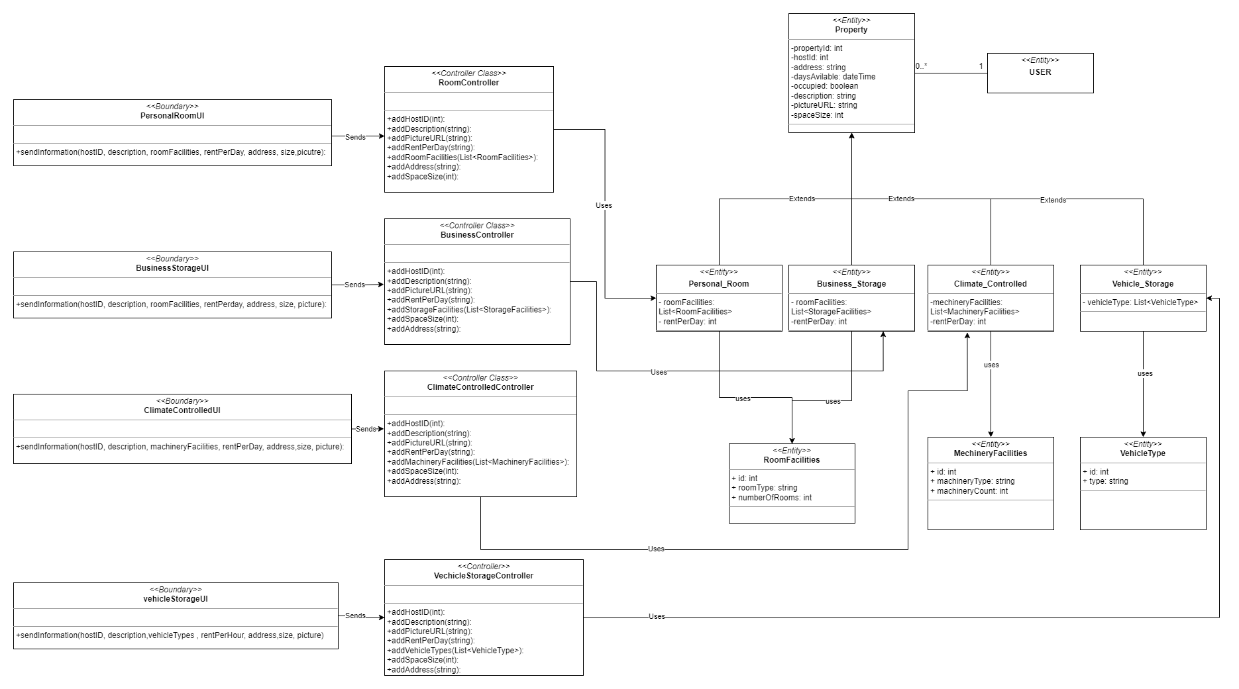
Hosting

Slide 5
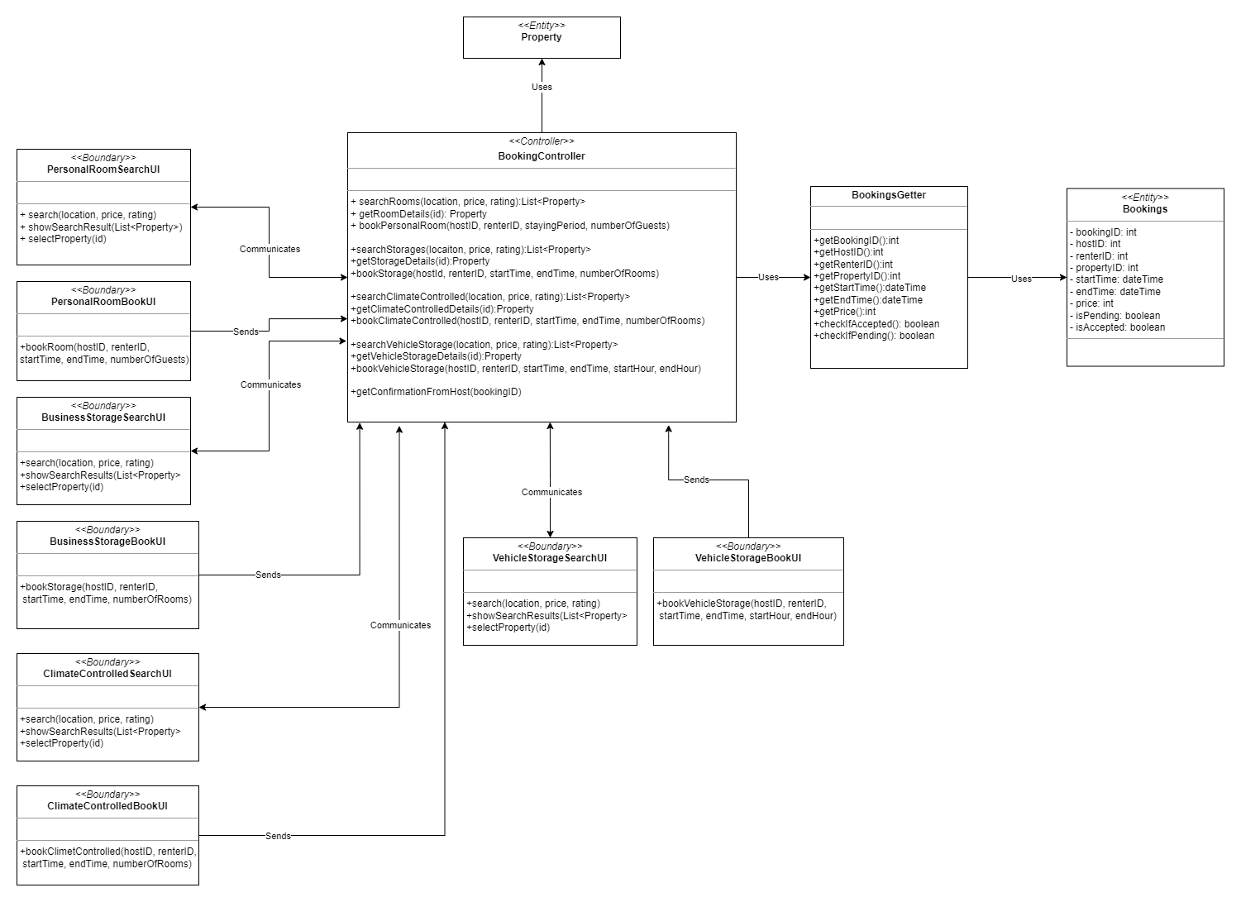
Renting

Slide 6
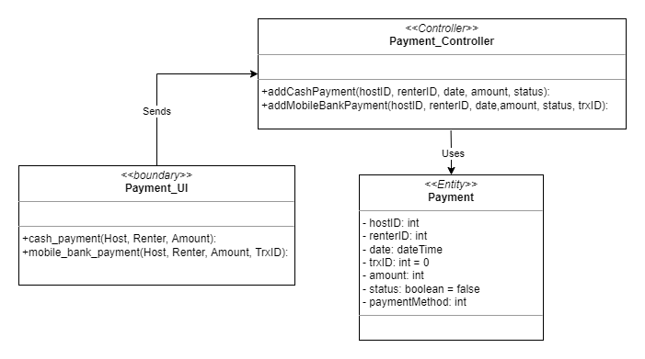
Payment

Slide 7
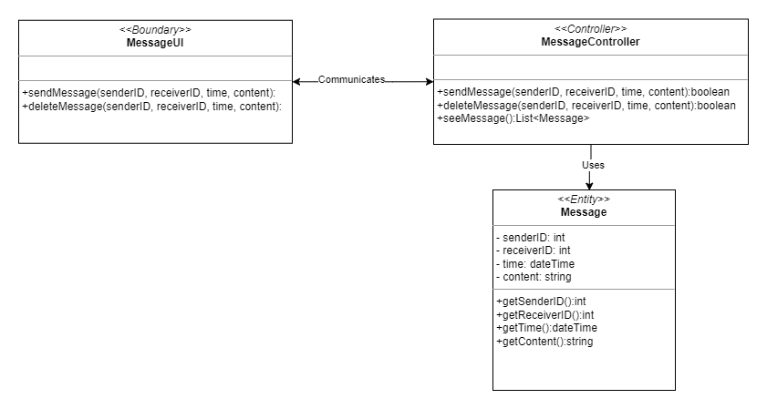
CHAT

Slide 8
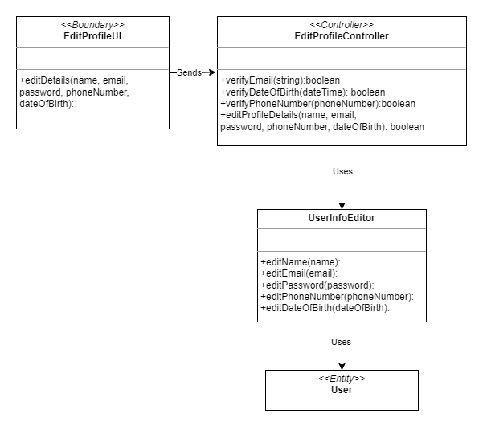
Edit profile

Slide 9
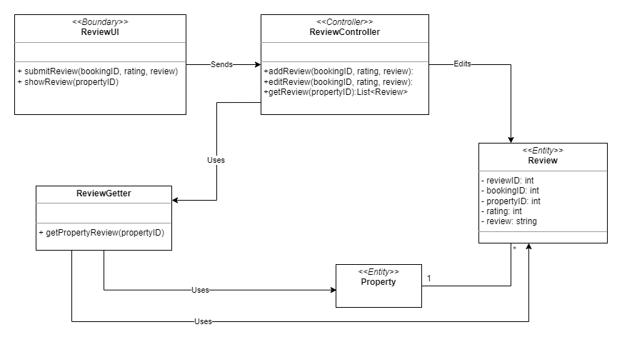
review

Slide 10
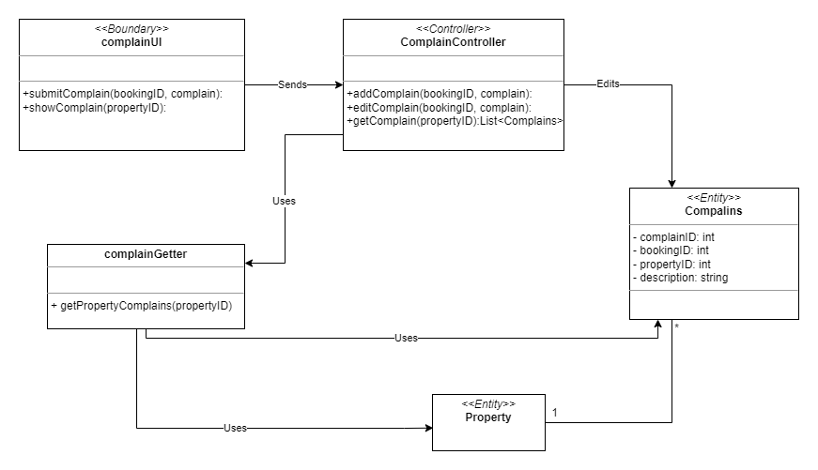
complain

